Slide 1

Progressive Education Society's
Modern College of Engineering,
Pune-411005
Department of MCA
Project Presentation On
RESULT ANALYSIS
By
Harmalkar Vinayak Manohar(51020) Badhe Chaitanya Gautam(51007) Jadhav Sneha Ravindra(51022) Khandelwal Shivam Ravindra(51030) Project Guide :
Prof. Dr. Rama Bansode.
Prof. Mrs. Netraja Mulay.

Slide 2
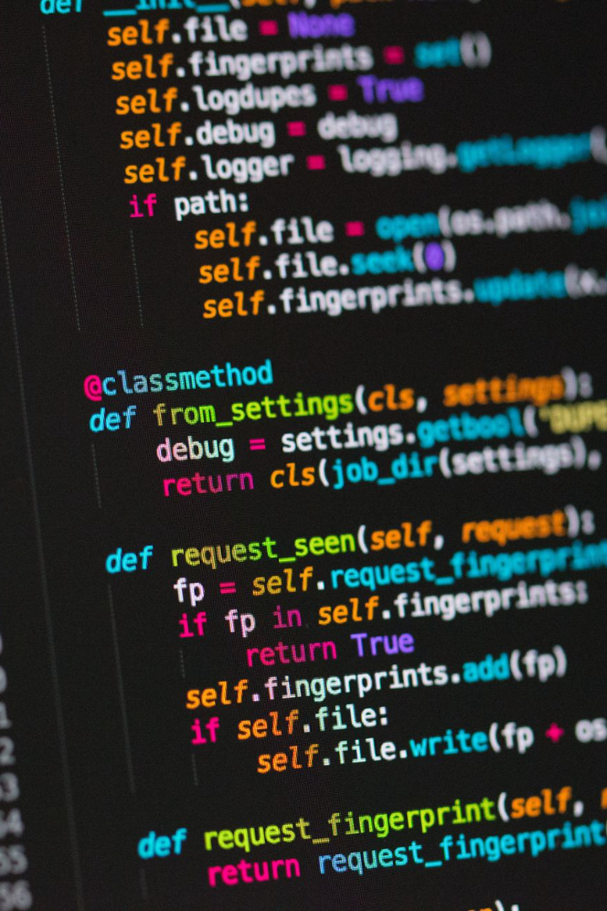
RESULT A ANALYSIS

Slide 3
Abstract
This project aims to develop a tool that takes a PDF file as input and performs an analysis on student data, specifically their marks. The application generates an Excel file containing the analyzed results. The user has the flexibility to choose the location where the file will be downloaded, allowing for easy access and further manipulation of the data.

Slide 4
Introduction
Project result analysis plays a crucial role in understanding the outcomes and effectiveness of a project. By analyzing project results, we can gain valuable insights, identify patterns, and make data-driven decisions for future improvements. Python, with its rich ecosystem of libraries and tools, provides a powerful platform for conducting project result analysis efficiently.
In this project, we will explore how Python can be used to analyze project results. We will leverage various Python libraries PyPDF2,Pandas to perform data manipulation data cleaning data filtration, etc.

Slide 5
Requirement Specification
Software specification:
Operating System : Windows
Language used: Python
Libraries used - PyPDF2,Tkinter,pandas
Hardware Specifications:
Processor Intel®Pentium®1.60GHz
RAM 4GB
System type 64-bit Operating System
Output Monitor
Input device Keyboard , Mouse

Slide 6
Objective
Automating data analysis and visualization, reducing manual errors
To make a system which will read data from PDF uploaded and generate an excel file which contains all exam related data of students with analyzed academic details

Slide 7
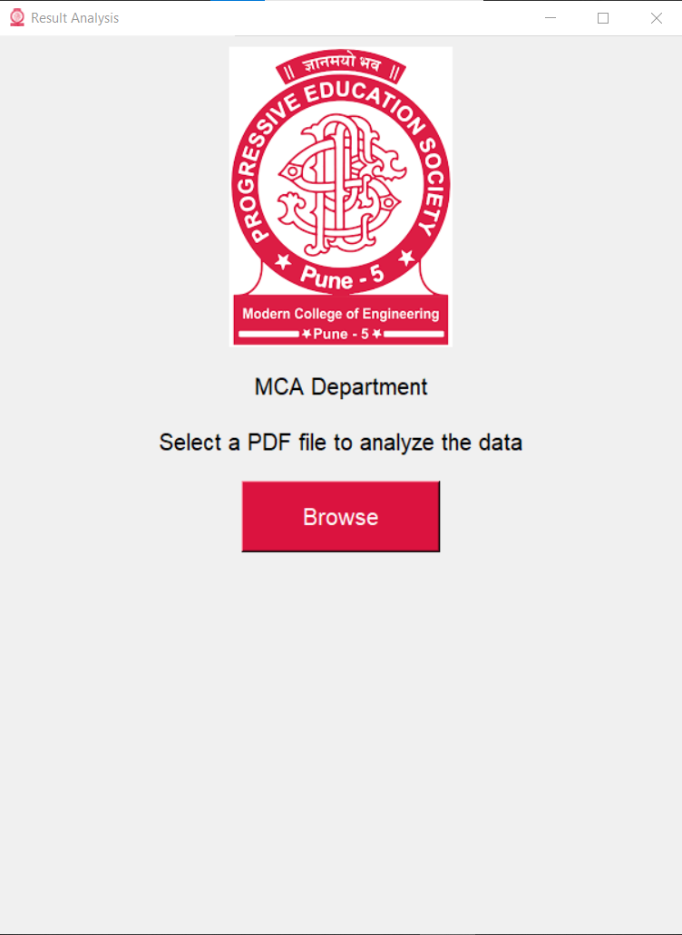
Screenshots

Slide 8
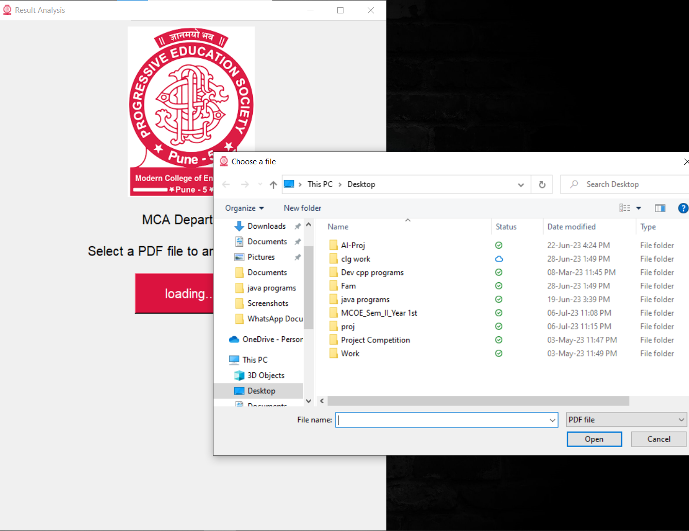

Slide 9
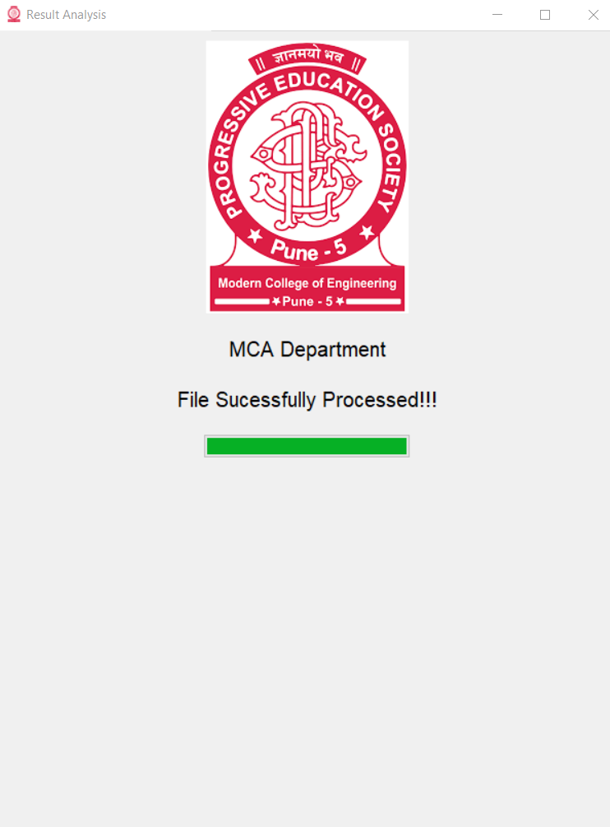

Slide 10
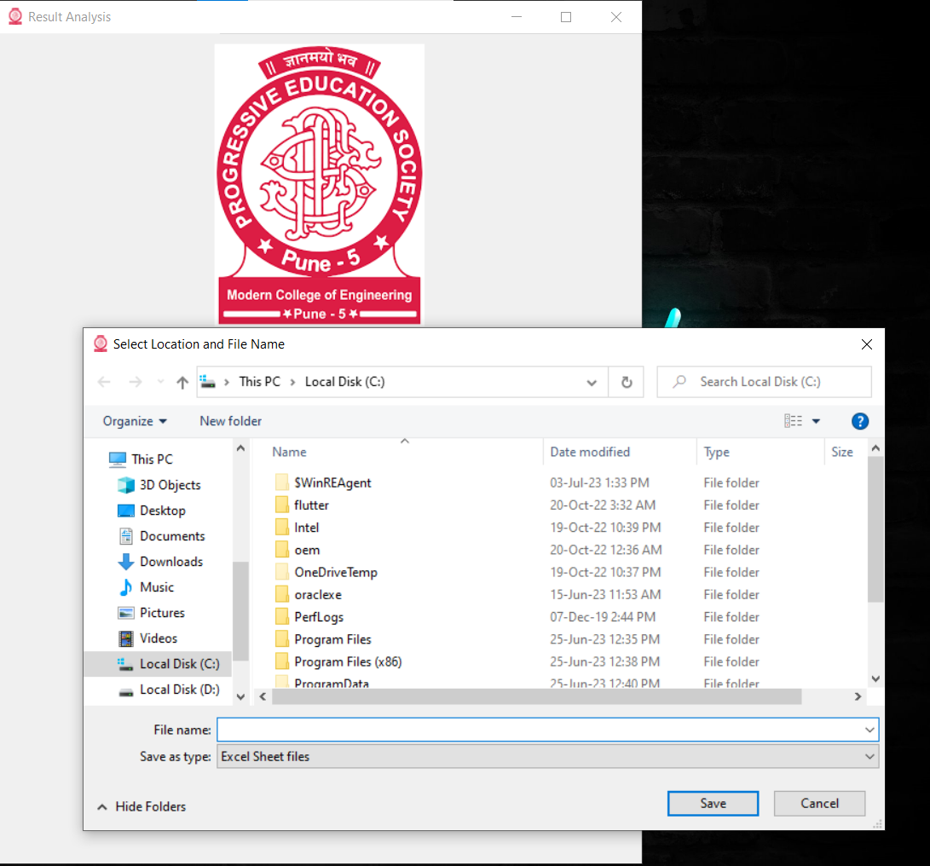

Slide 11
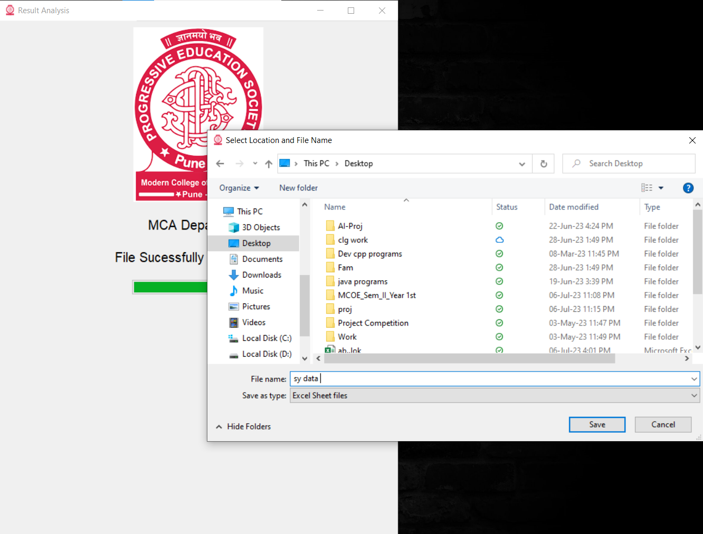

Slide 12
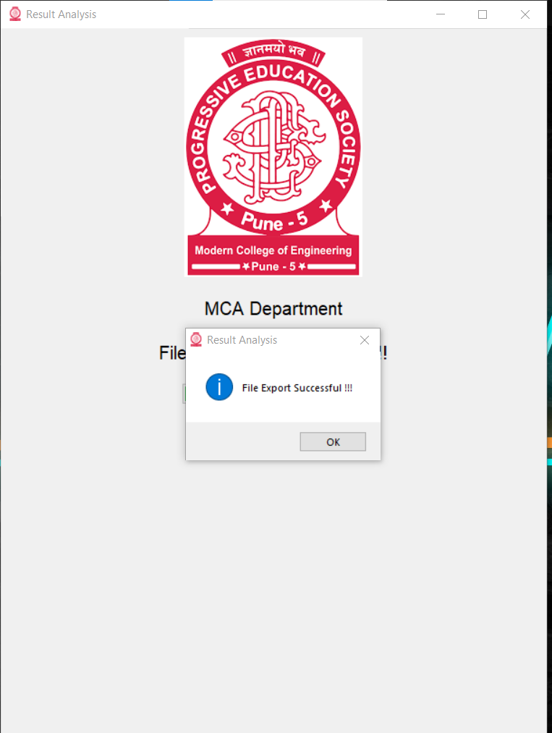

Slide 13
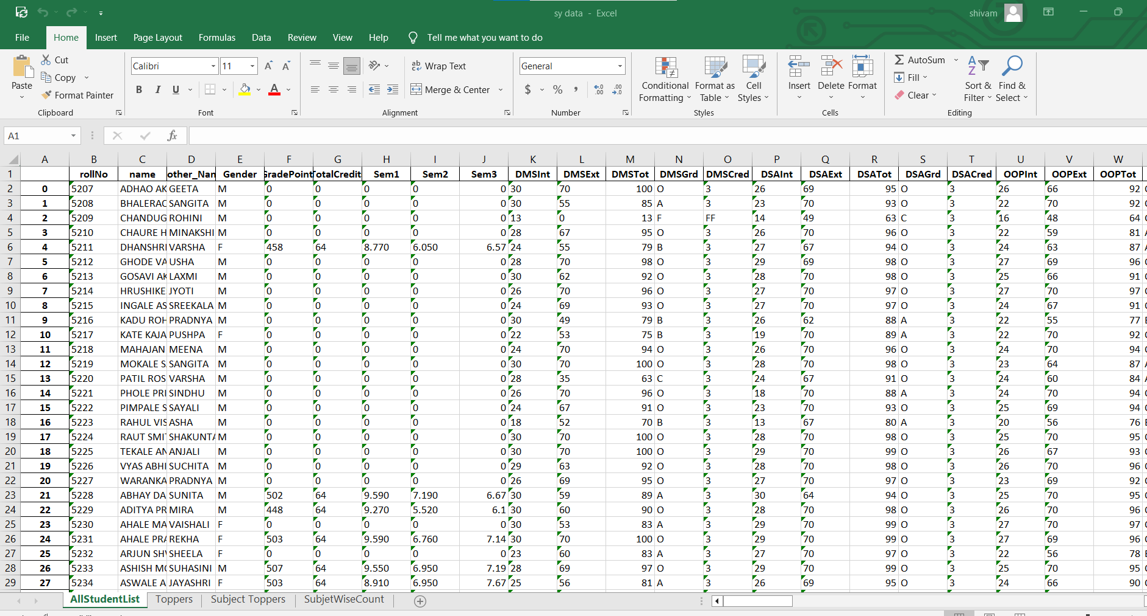

Slide 14
Working
The application takes a PDF file as input and performs an analysis of student data, specifically utilizes string manipulation techniques in Python to clean and extract relevant information from the PDF document. Once the data is extracted and cleaned, relevant formulas are applied to perform analysis on the student mark.
The process begins with parsing the PDF file and identifying the necessary sections containing student data. By employing string manipulation techniques, the relevant data is extracted and formatted to ensure consistency and accuracy. Cleaning the data involves removing any unnecessary characters, correcting formatting issues, and addressing missing or erroneous entries.
Once the data is cleaned, the project employs predefined formulas to analyze the student marks. The analysis aims to provide insights into the performance and distribution of marks among the students.

Slide 15
Finally, the project generates an Excel file containing the analyzed results. The user has the flexibility to choose the download location, allowing easy access and further manipulation of data. The Excel file includes formatted tables that present the analyzed data in a clear and comprehensive manner.
Overall, this project provides a robust and efficient solution for analyzing student data from PDF files. By leveraging string manipulation techniques, predefined formulas, and Excel file generation, it simplifies the process of marks entry and applying formulas manually for analysis of student's marks which saves time and efforts.

Slide 16
Future Scope
Can be used by the other Engineering Departments of Pune University.
Can be used by Other Universities.
Can be used by other colleges by making some modifications it can be made universal.

Slide 17
CONCLUSION
In summary, the software application efficiently extracts and cleans student data from PDF files using string manipulation techniques in Python. By applying predefined formulas, it performs comprehensive analysis on student marks, providing valuable insights into their performance and mark distribution. The application generates an Excel file with formatted tables for easy access and further manipulation of data. Overall, this project offers a robust and time-saving solution for analyzing student data, simplifying the process of marks entry and analysis.

Slide 18
LIMITATION
Processing speed: Python is an interpreted language, which means it can be slower than compiled languages like C or Java. When dealing with large datasets or complex calculations, Python may not offer the same level of performance.
Memory usage: Python can consume a significant amount of memory, especially when working with large datasets. This can become a limitation when analyzing data that exceeds the available memory on your machine
we can convert only pdf file.

Slide 19
References
https://docs.python.org/3/library/tkinter.html
https://pypdf2.readthedocs.io/en/3.0.0/
https://www.youtube.com

Slide 20
Thank You !!!

